Slide 1
TypeScript
Trần Minh

Slide 2
Course Overview

Slide 3
Why do we use TypeScript?
Basic Types & Variable declarations.
Interfaces – Classes – Functions – Generics
Modules
Project Configuration
Q&A

Slide 4
Why do we use TypeScript

Slide 7
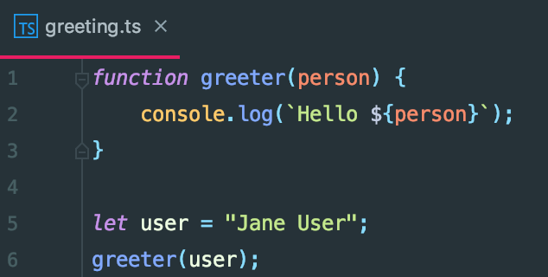
How to run and test TypeScript
Install TypeScript
npm install –g typescript
Building your first TypeScript file:

Slide 8
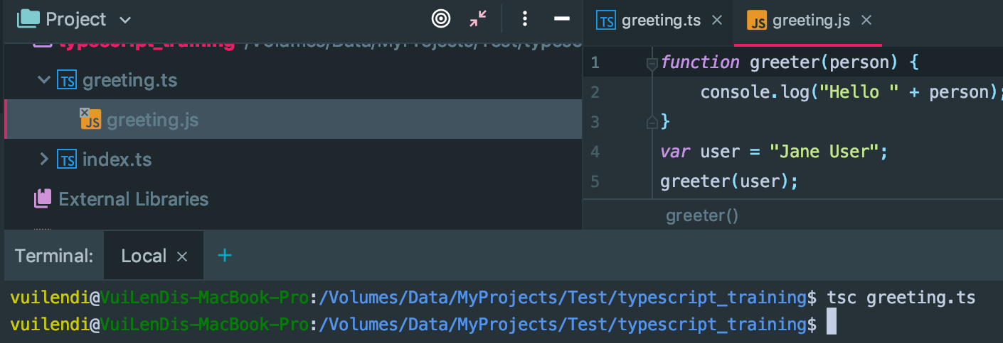
How to run and test TypeScript (2)
Use typescript CLI to build

Slide 9
Basic Types
numbers, strings, structures, boolean values, etc.

Slide 10
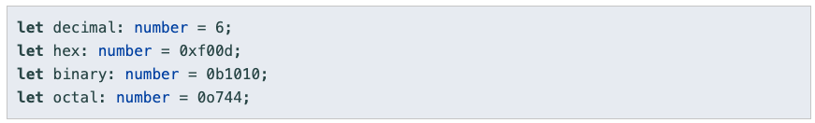
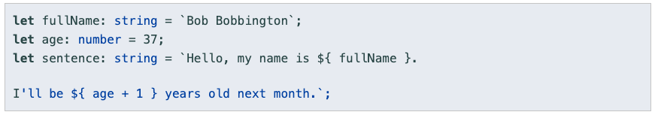
[var | let | const] variableName: type
Number
String

Slide 11
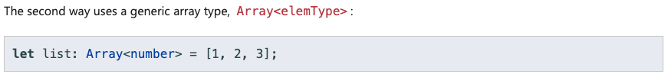
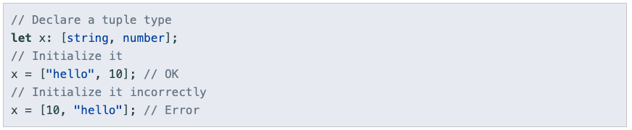
Boolean
Array
Tuple

Slide 12
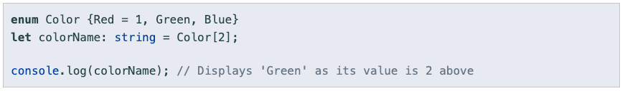
Enum

Slide 13
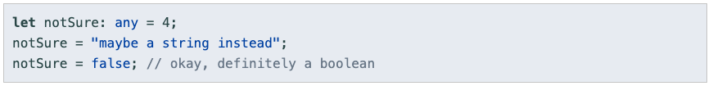
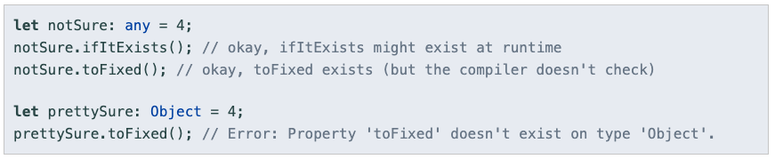
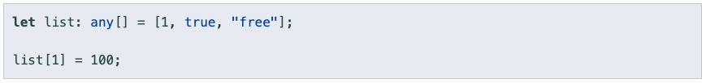
Any

Slide 14
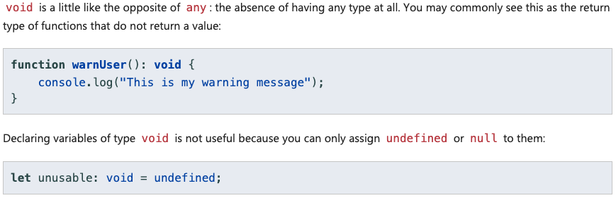
Void

Slide 15
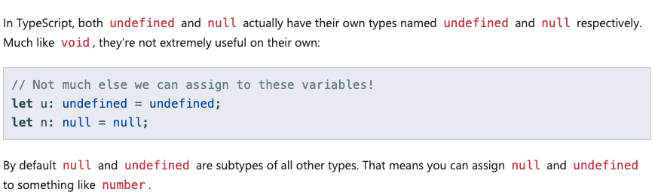
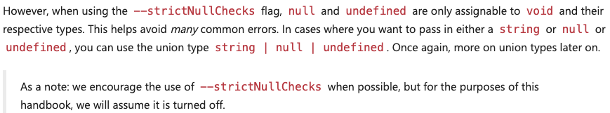
Null and Undefined

Slide 16
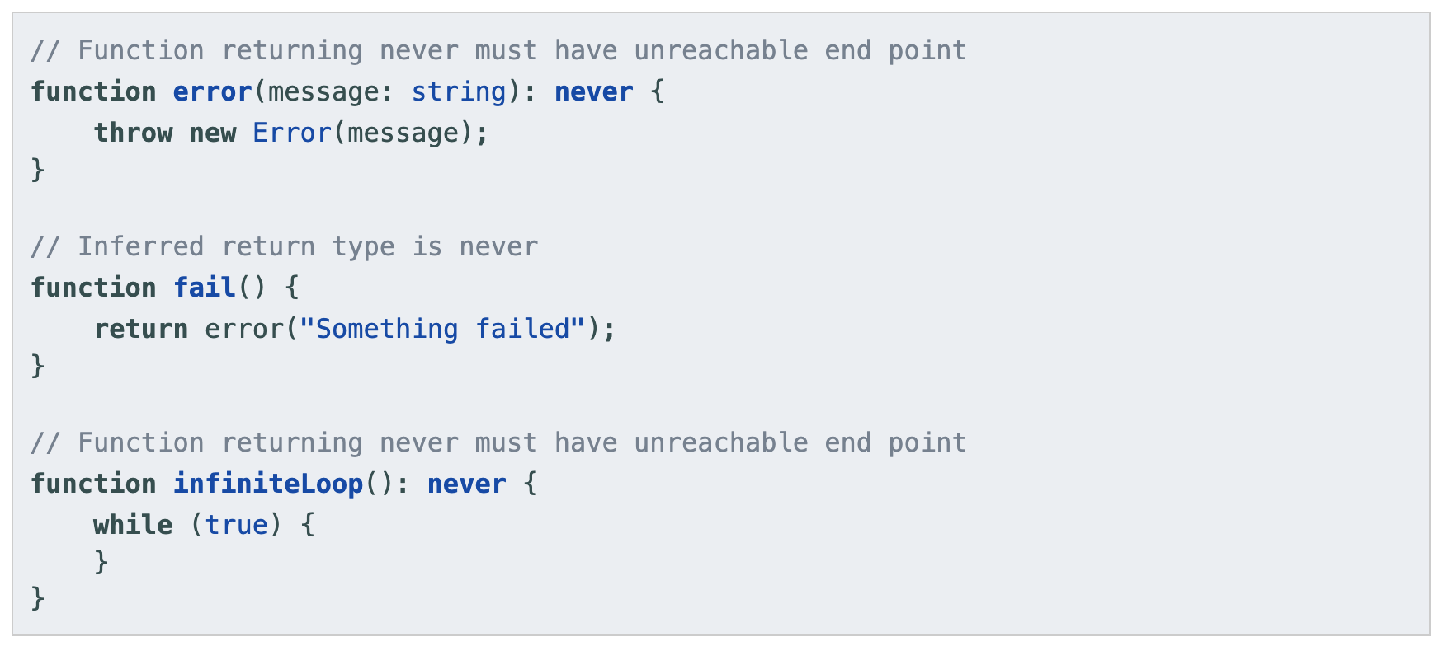
Never

Slide 17
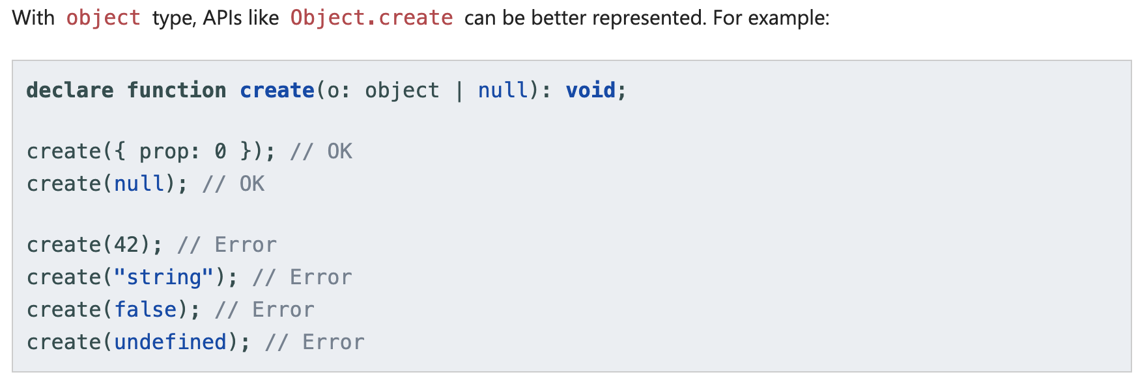
Object

Slide 18
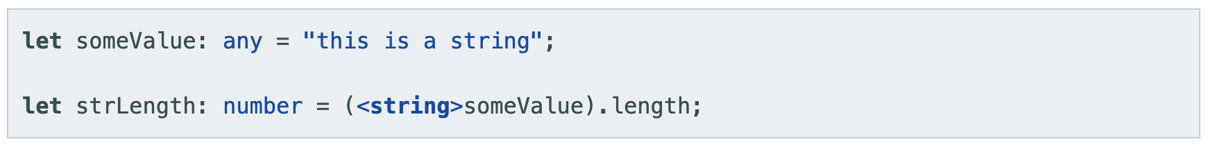
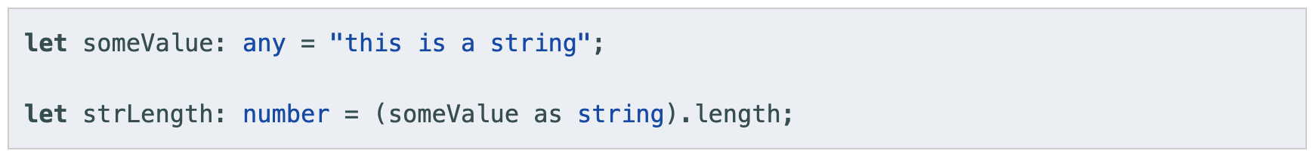
Type assertions
A type assertion is like a type cast in other languages, but performs no special checking or restructuring of data

Slide 19
Variable Declare
Var – Let - Const

Slide 20
Variable Declarations
var is global-scoping, can re-declare multi-times
let is block-scoping
const have same scoping rule as let, but you can’t re-assign to them. The internal state of a const variable is still modifiable

Slide 21
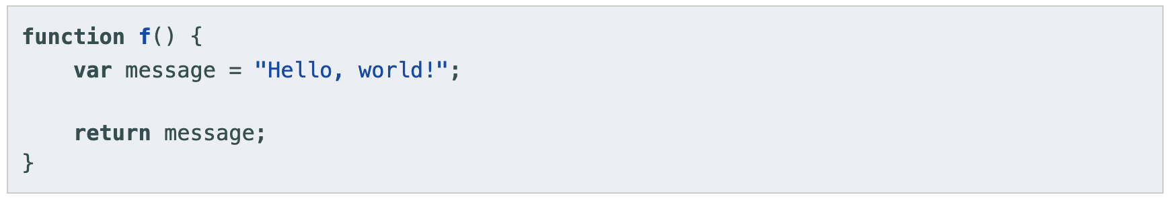
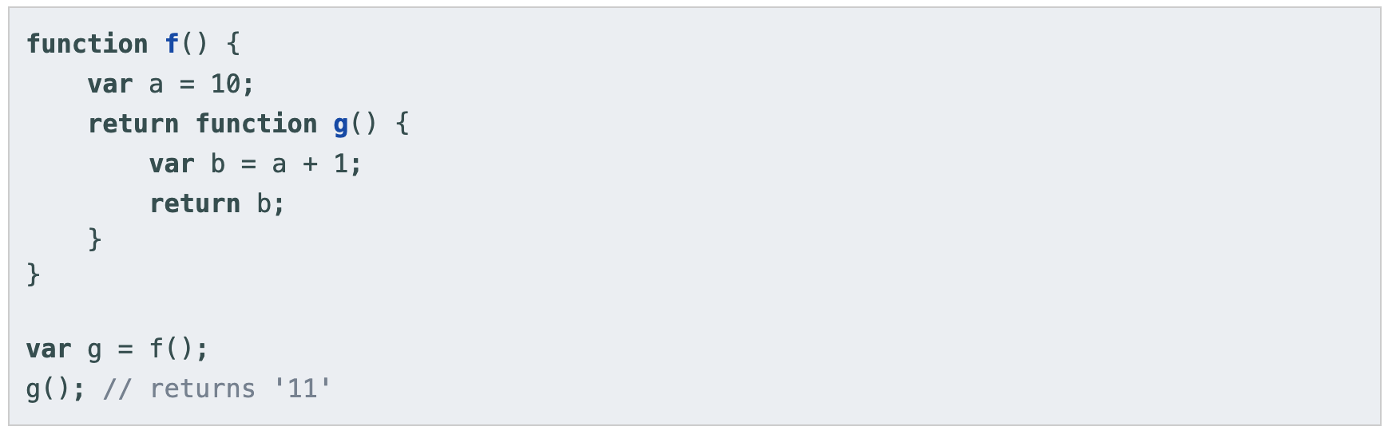
var declarations

Slide 22
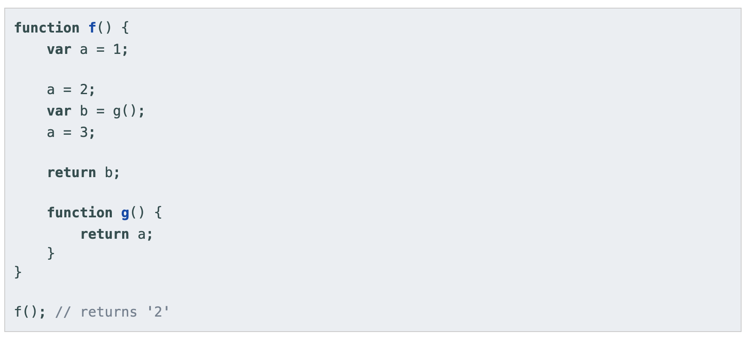
var declarations

Slide 23
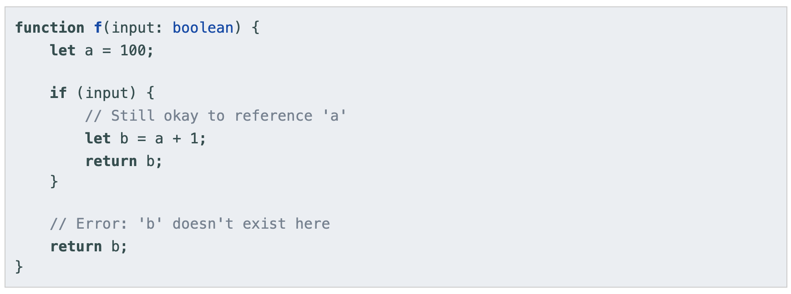
let declarations

Slide 24
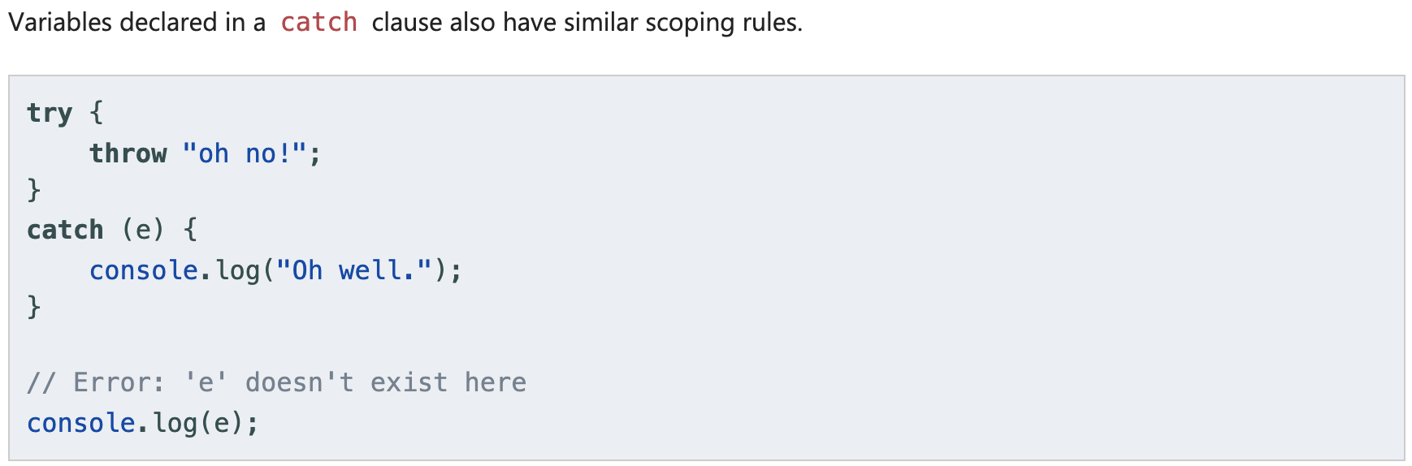
let declarations

Slide 25
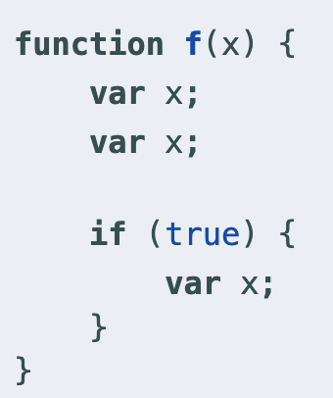
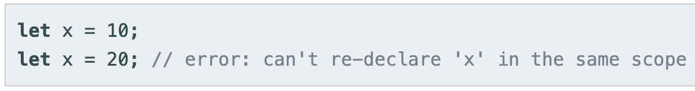
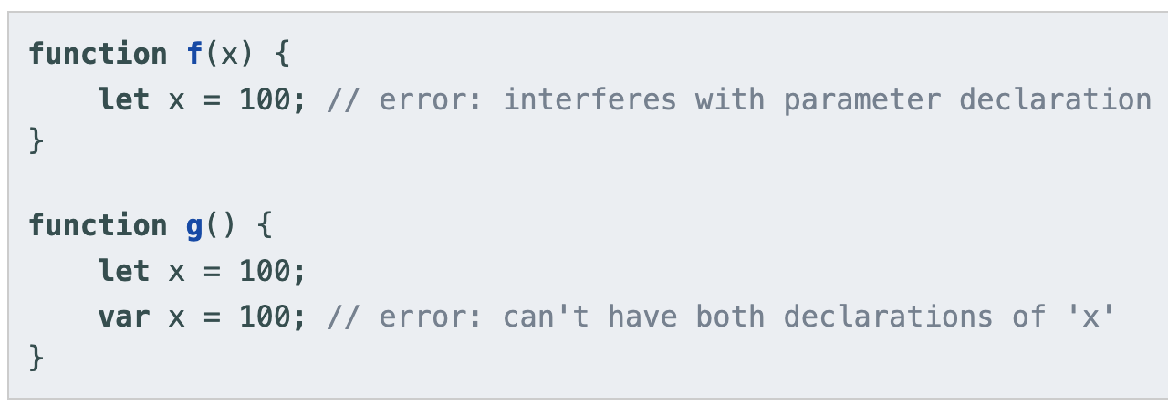
Re-declarations and Shadowing
var
let

Slide 26
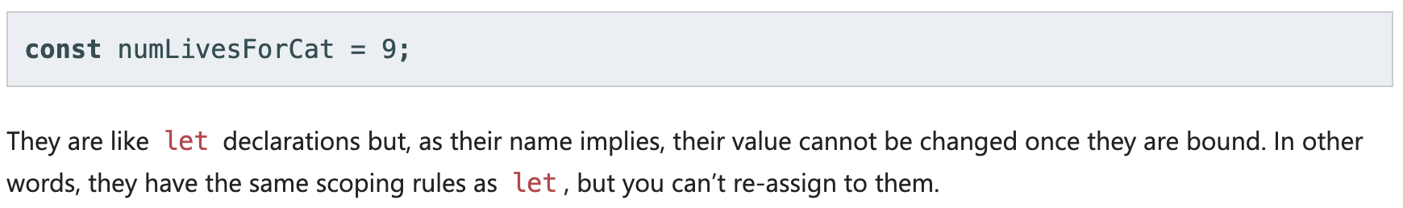
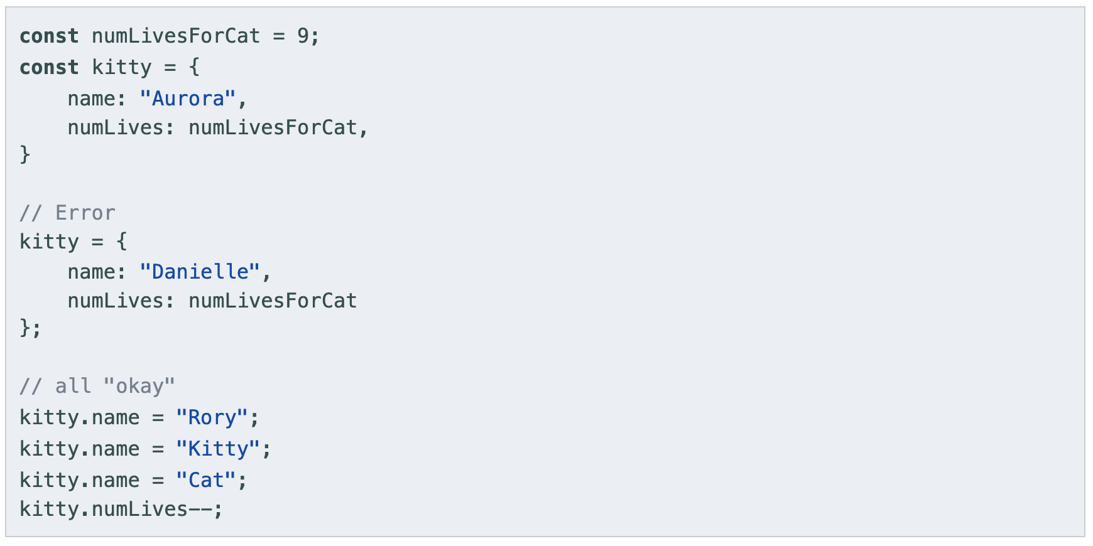
const declarations

Slide 27
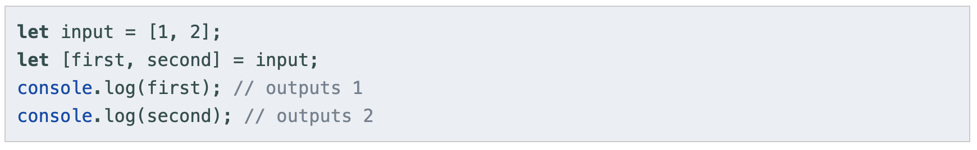
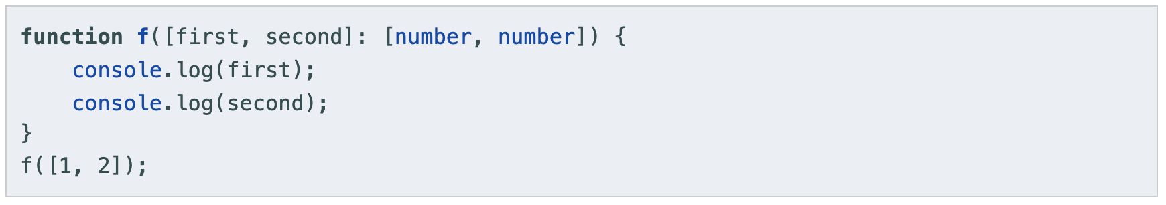
Destructuring
Array destructing

Slide 28
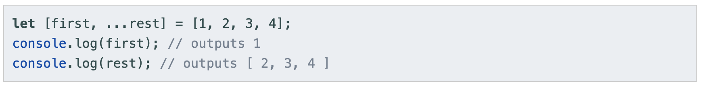
Destructuring (2)
Array destructing

Slide 29
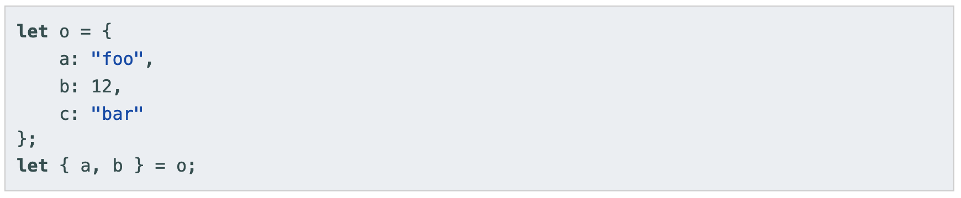
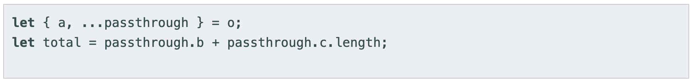
Destructuring (3)
Object destructing

Slide 30
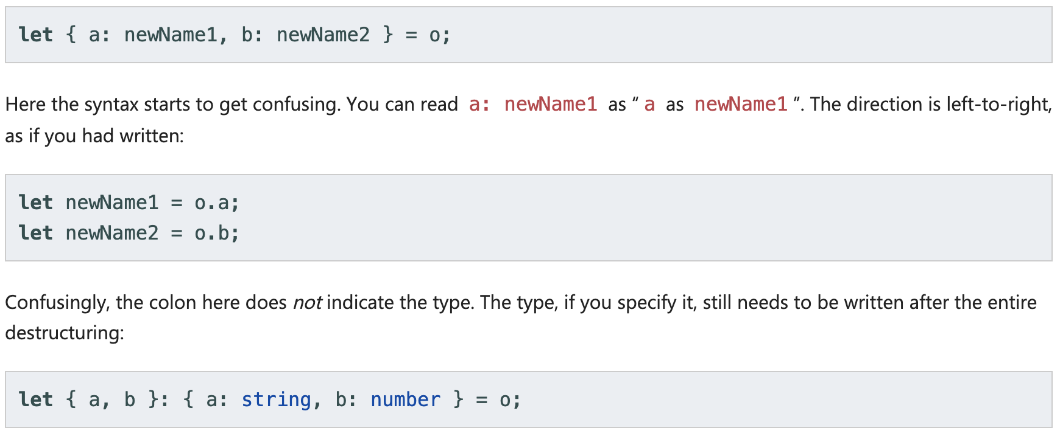
Destructuring (4)
Object destructing
Property renaming

Slide 31
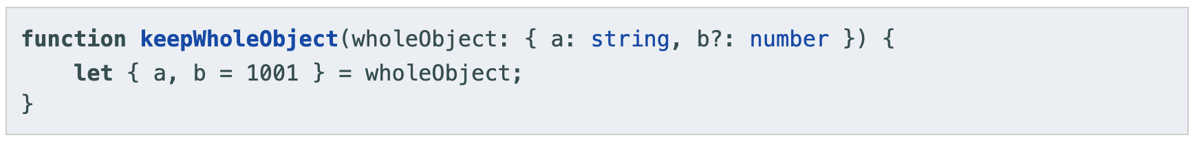
Destructuring (5)
Object destructing
Default values

Slide 32
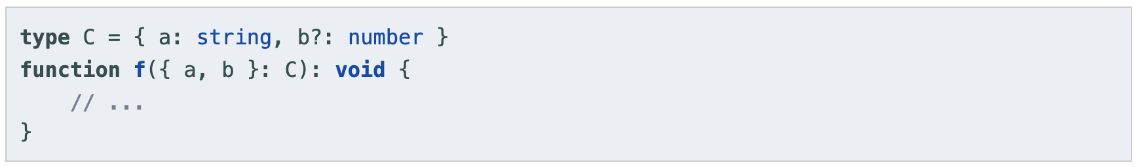
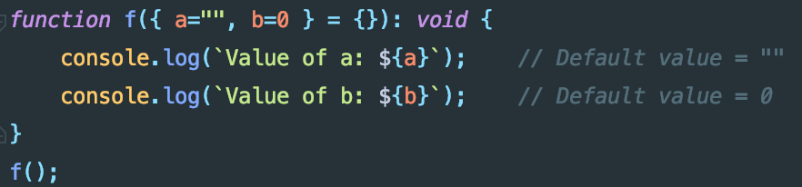
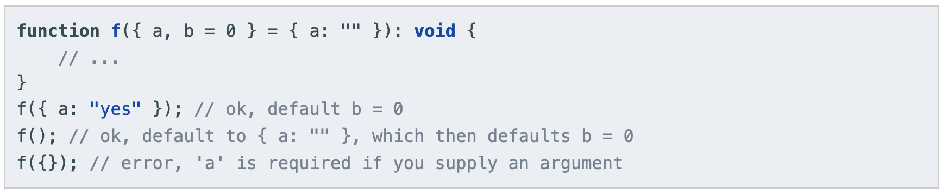
Destructuring (6)
Function declarations

Slide 33
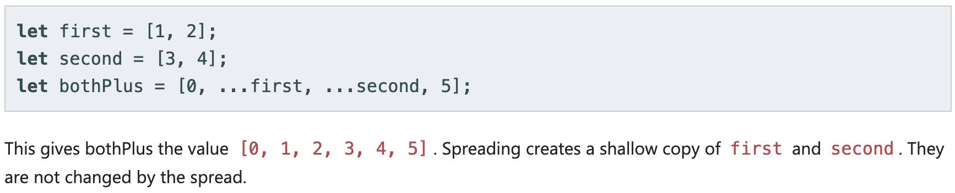
Destructuring (7)
Spread

Slide 34
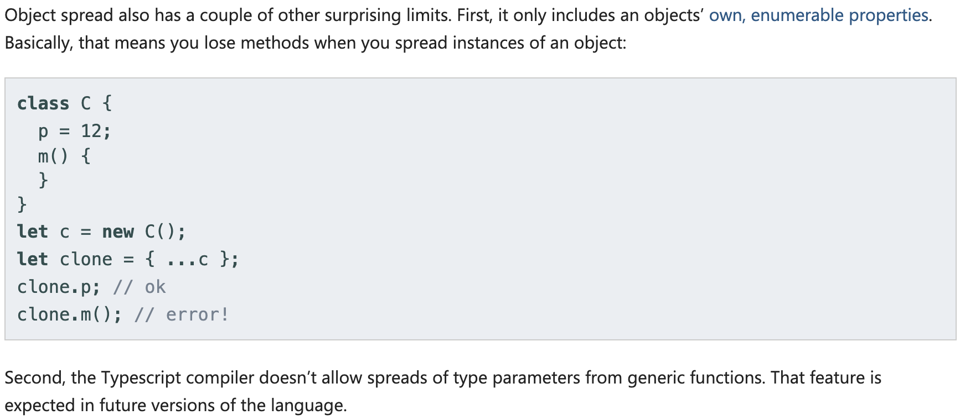
Destructuring (8)
Spread

Slide 35
Interfaces – Classes – Functions

Slide 36
Interfaces

Slide 37
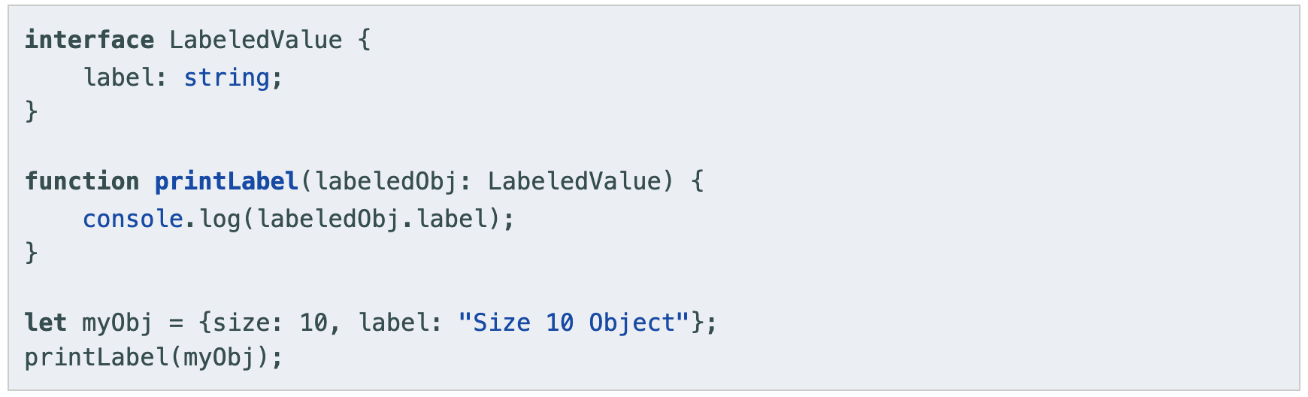
Interfaces

Slide 38
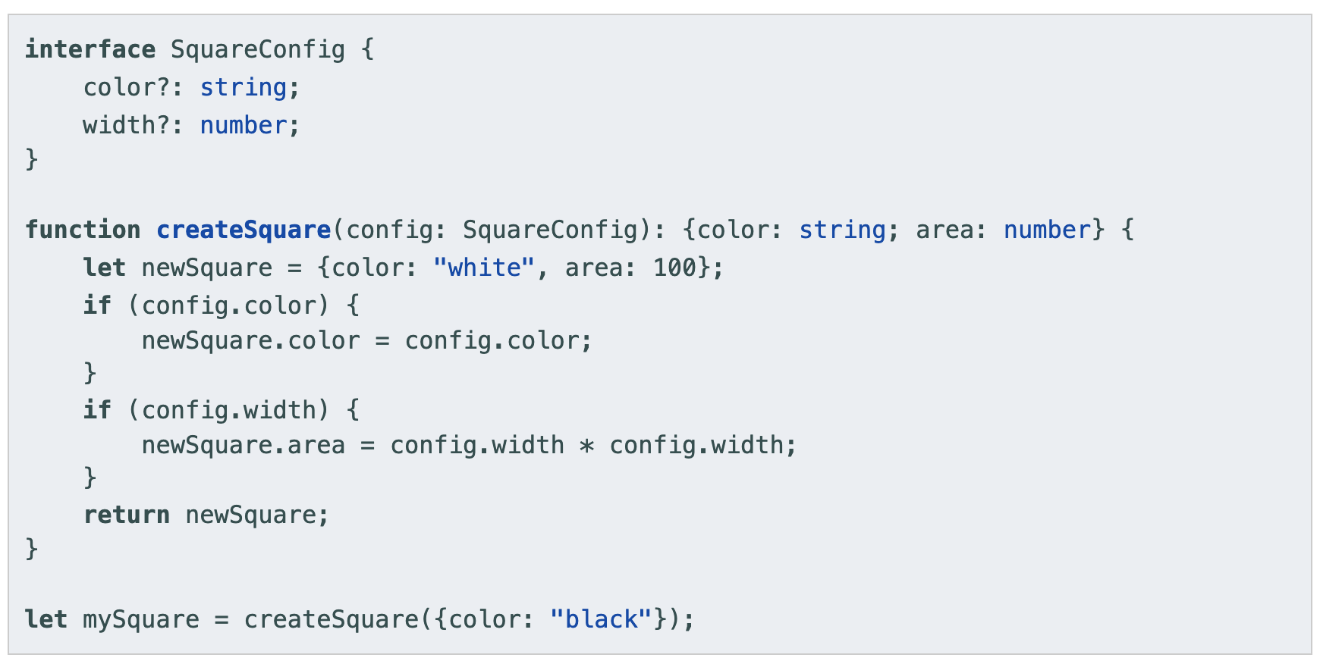
Optional Properties

Slide 39
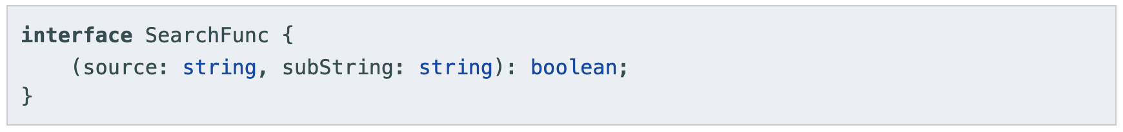
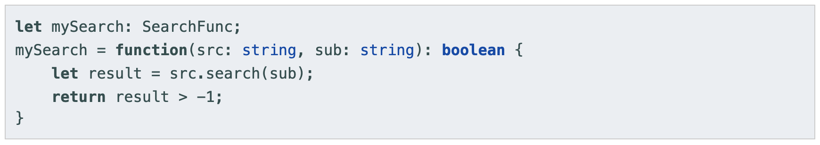
Function Types

Slide 40
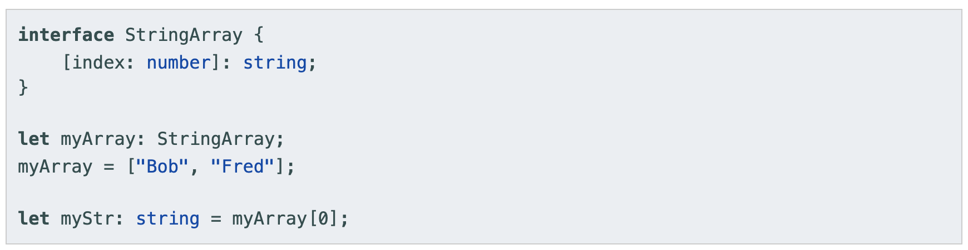
Indexable Types

Slide 41
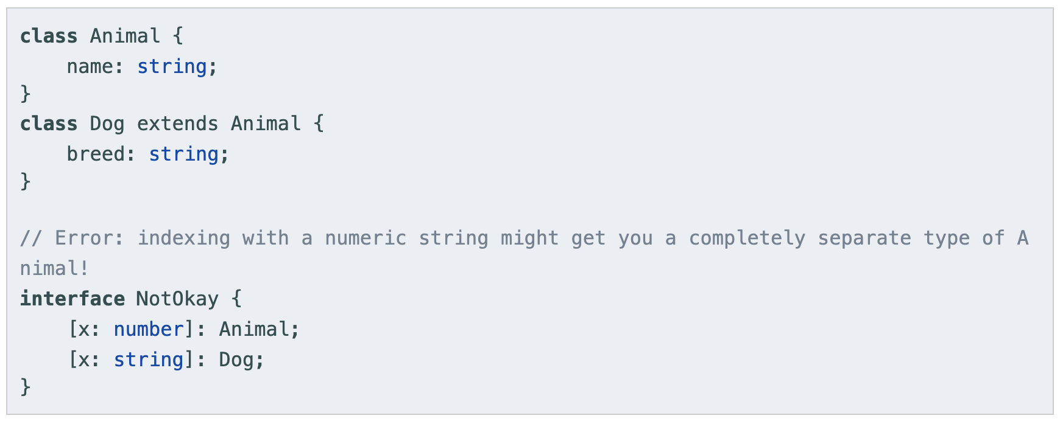
Indexable Types

Slide 42
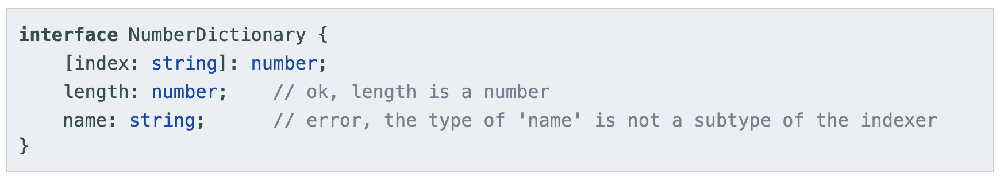
Indexable Types

Slide 43
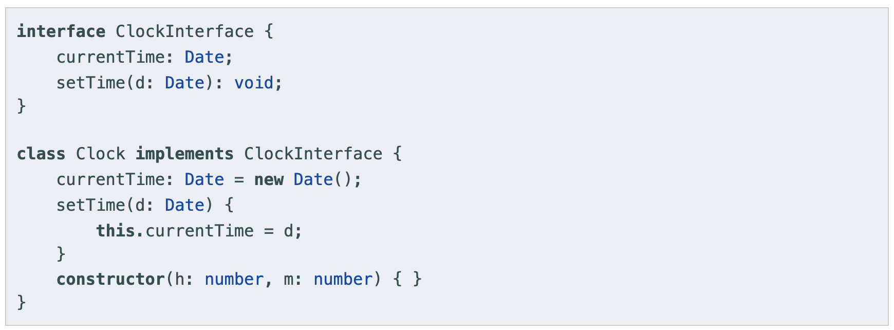
Class Types
Implementing an interface

Slide 44
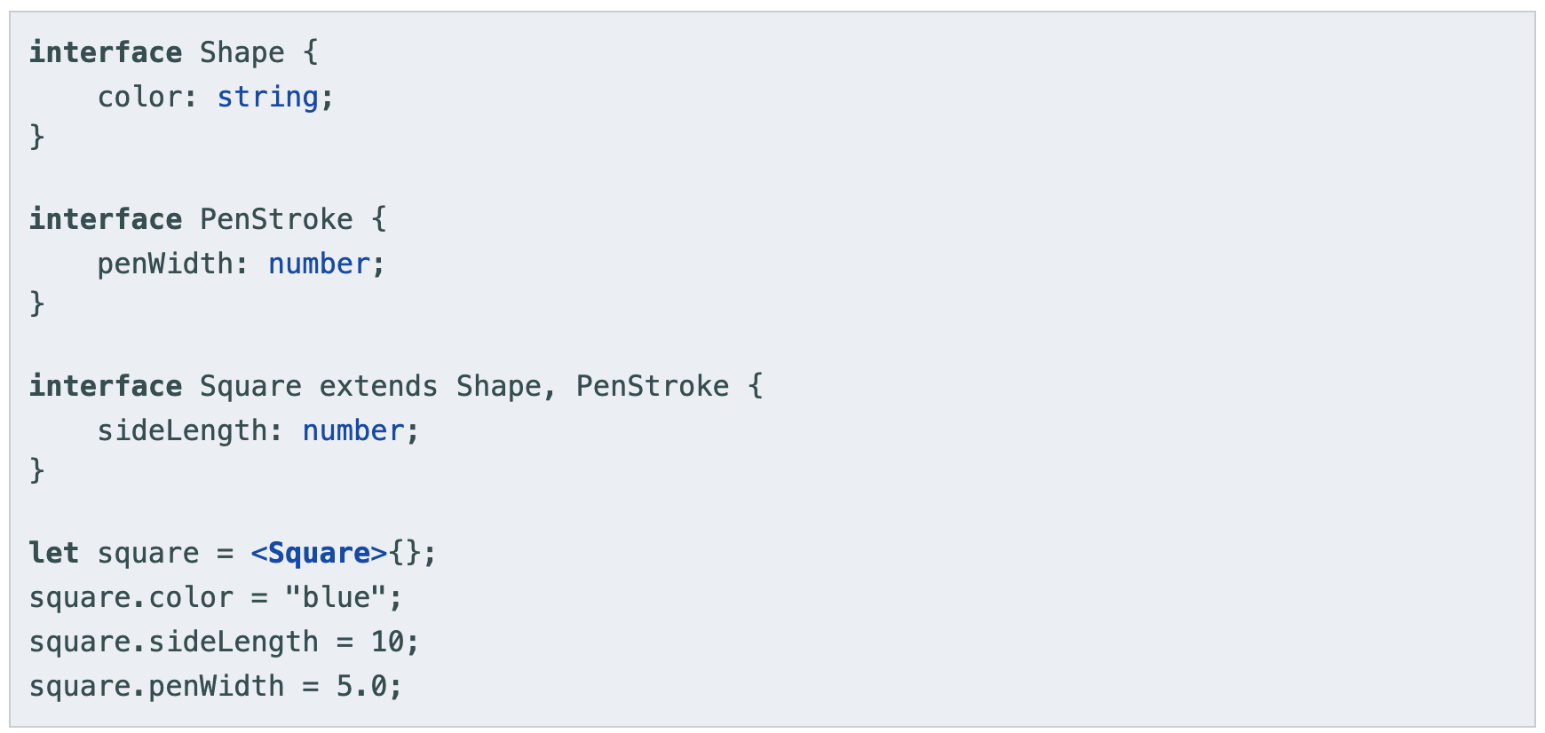
Extending Interfaces

Slide 45
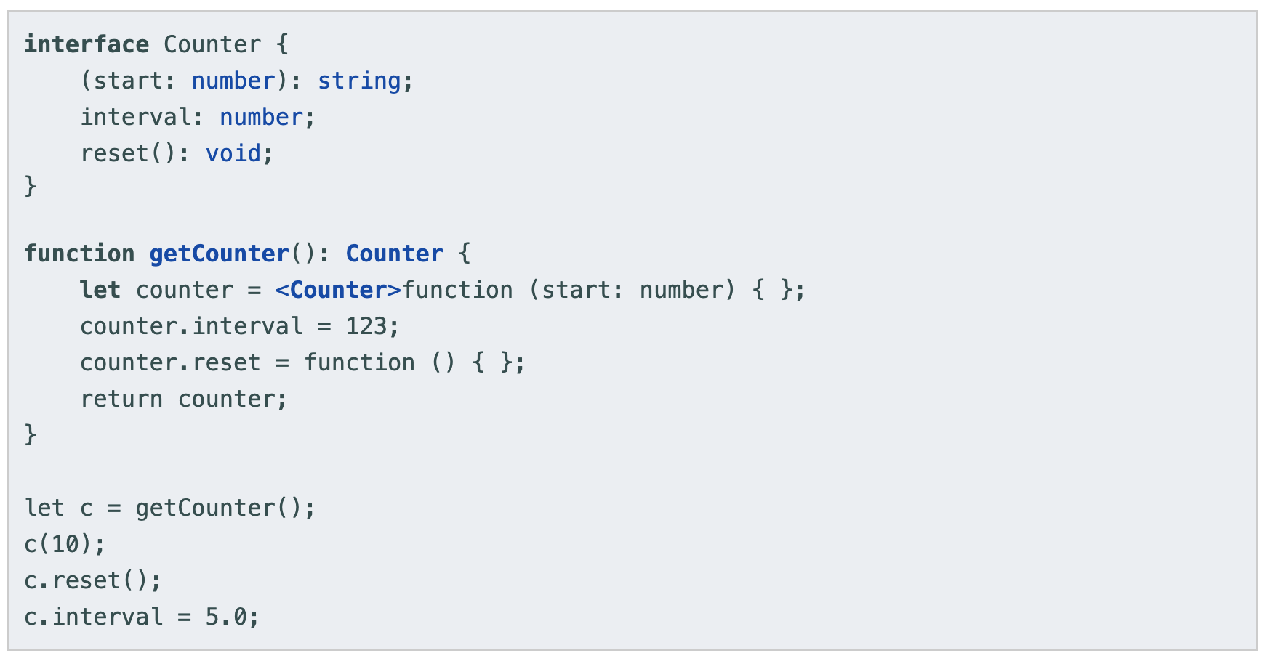
Hybrid Types

Slide 46
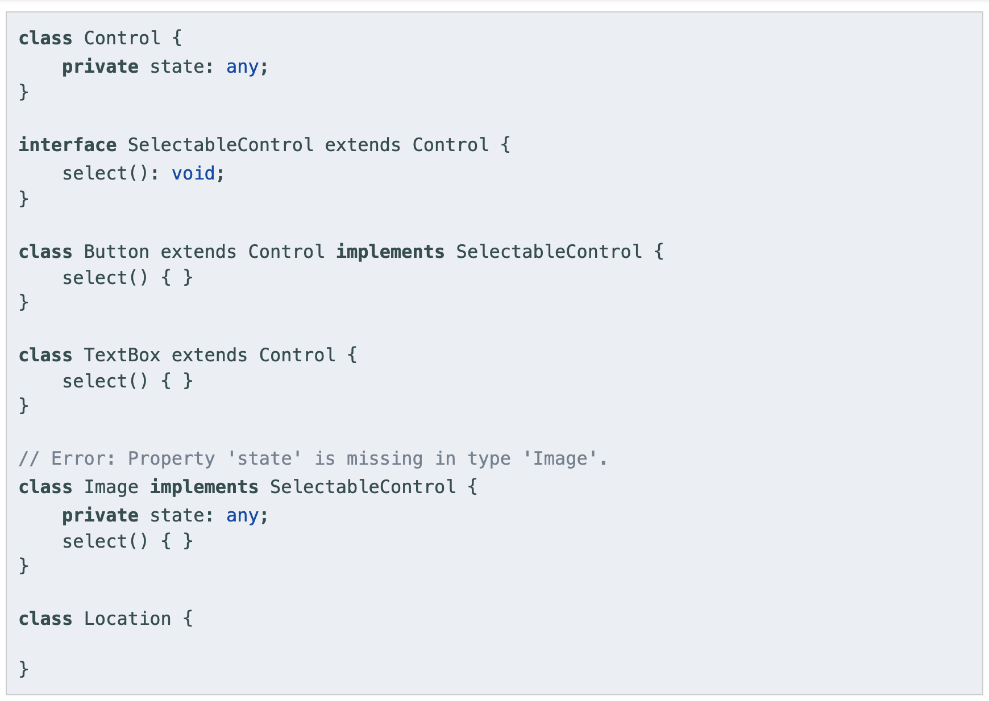
Interfaces Extending Classes

Slide 47
Classes

Slide 48

Classes

Slide 49

Inheritance

Slide 50

Public, private, and protected modifiers
Public is default
In TypeScript, each member is public is default
Private
When a member is marked private, it cannot be accessed from outside of its containing class
Protected
The protected modifier acts much like the private modifier with the exception that members declared protected can also be accessed within deriving classes

Slide 51

Accessors
TypeScript supports getters/setters as a way of intercepting accesses to a member of an object

Slide 52

Static Properties
Those that are visible on the class itself rather than on the instances

Slide 53

Abstract Class
Abstract classes are base classes from which other classes may be derived
They may not be instantiated directly
An abstract class may contain implementation details for its members
Methods within an abstract class that are marked as abstract do not contain an implementation and must be implemented in derived classes
Both define the signature of a method without including a method body.

Slide 54
Functions

Slide 55


Functions

Slide 56

Optional and Default Parameters
In TypeScript, every parameter is assumed to be required by the function. This doesn’t mean that it can’t be given null or undefined

Slide 57

Optional and Default Parameters

Slide 58


Rest Parameters

Slide 59
Generics

Slide 60



Generics

Slide 61


Generics (2)

Slide 62
Modules

Slide 63
Modules
Starting with ECMAScript 2015, JavaScript has a concept of modules. TypeScript shares this concept.
Modules are executed within their own scope, not in the global scope
Declared in a module are not visible outside the module unless they are explicitly exported using one of the export forms
Modules are declarative; the relationships between modules are specified in terms of imports and exports at the file level.

Slide 64

Export
Exporting a declaration

Slide 65

Export
Export statements

Slide 66


Export
Re-exports

Slide 67

Import
Not Recommend Practice
Though not recommended practice, some modules set up some global state that can be used by other modules. These modules may not have any exports, or the consumer is not interested in any of their exports. To import these modules, use:

Slide 68

Default exports

Slide 69

Default exports

Slide 70

Default exports

Slide 71

Default exports

Slide 72
Project Configuration

Slide 73
tsconfig.json
The presence of a tsconfig.json file in a directory indicates that the directory is the root of a TypeScript project.
The tsconfig.json file specifies the root files and the compiler options required to compile the project
A project is compiled in one of the following ways:
By invoking tsc with no input files, in which case the compiler searches for the tsconfig.json file starting in the current directory and continuing up the parent directory chain
By invoking tsc with no input files and a --project (or just -p) command line option that specifies the path of a directory containing a tsconfig.json file, or a path to a valid .json file containing the configurations.

Slide 74


Slide 75


Slide 76
Q&A

